Slide 1
Using OER at PSU
By Ruth Monnier, Learning Outreach Librarian
&
Kristen Livingston, Assistant Professor
CC BY-SA 4.0

Slide 2
Introductions
Who is in the room where it is happening?
Share your name, department, and your familiarity with OER
"Hamilton on Broadway in NYC" by Lori L. Stalteri is licensed under CC BY 2.0.

Slide 3
What is OER?
“Open Educational Resources (OER) are teaching, learning, and research materials that are either (a) in the public domain or (b) licensed in a manner that provides everyone with free and perpetual permission to engage in the 5R activities.”
The 5 Rs:
Retain – make, own, and control a copy of the resource
Reuse – use your original, revised, or remixed copy of the resource publicly
Revise – edit, adapt, and modify your copy of the resource
Remix – combine your original or revised copy of the resource with other existing material to create something new
Redistribute – share copies of your original, revised, or remixed copy of the resource with others
From https://creativecommons.org/about/program-areas/education-oer

Slide 4
What is OER?
What formats are included?

Slide 5
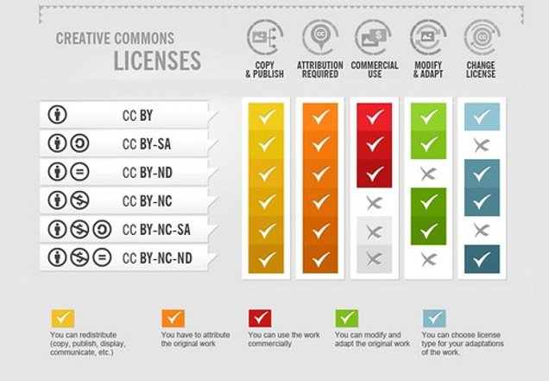
Signposts of OER
CC Licenses
"Creative Commons Licenses Infographic" by ricardo56 is licensed under CC BY-SA 2.0

Slide 6
Faculty Considerations
Selecting a text
As you suggest for your students, always double check authors, contents, for credibility.
Accuracy
Relevance
Production Quality
Accessibility
Interactivity
Licensing
A textbook may help frame your curriculum, however, single source selections (articles, videos, etc.) may better serve the purpose of instruction of your subject matter.
Some texts are poorly written- like physical textbooks. If they are difficult to for you to read, your students won't open them (sound familiar).

Slide 7
Faculty Considerations – Locating OER
OpenStax- free account for PowerPoints, LMS suggestions, curriculum guides
OERCommons- public digital library within the global educational community
Open Textbook Library- open textbooks licensed by authors and publishers for free use. 1053 textbooks are available from a variety of fields
BC Campus: Open Ed – open.bccampus.ca
Lumen Learning/Course Hero – coursehero.com
MERLOT – merlot.org- Free and open international online development service
Open Textbook Library – open.umn.edu
Coursera – coursera.org
Future Learn – futurelearn.com
The Open University - open.edu/openlearn
TEDEd – ed.ted.com
University Videos - universityvideos.org

Slide 8
Faculty Considerations
Alternative considerations
YouTube videos- TedX
News Articles- AP news (Example: CNN, Fox, MSNBC, and News Max).
Documentaries
Interactive web content
Online Certification courses
Structured with videos, quizzes, handouts
Gamification- game like learning enhancements known to help with competition and subject matter education

Slide 9
Faculty Considerations
ZTC (Zero Textbook Cost)
Benefits:
Appealing for students
No additional costs or fees
OER may have pdf or online interactive versions
How to make your class ZTC:
Contact registrar
Work with your administrative assistant when creating schedule to ensure it has the ZTC designation
Can go through bookstore to designate that your class doesn't need a physical, cost-driven requirement.

Slide 10
Showcasing & Marketing OER
Creative Commons Licensing
Decide which CC license is appropriate for the work you wish to distribute
CC0 – waive interests worldwide
Public Domain Mark- free of known copyright restrictions
Important because licensing your product could determine HOW a user interacts with it.
Advocating benefits of OER (to students and faculty)
Proof is in the pudding
Measure student success in your classroom
Share materials
Make friends with your campus librarian
Cost/benefit breakdown
Professional Development/Conference Exposure

Slide 11
Tips & Tricks for Finding OER
Searching
What is your purpose?
“Public Domain”
Multiple repositories at once with MOM
https://oer.deepwebaccess.com/oer/desktop/en/search.html
Use filters
Places to Go:
Canvas Commons
OER Libguide
CreativeCommons Search

Slide 12
Your Turn!
What are you looking for? (format, content, etc.)
What do you want to do with OER material? (plug and go, change for your needs, etc.)
What do you hope to do with OER material(s) in your courses?

Slide 13
Wrap-Up
What is your takeaway?

